Slide 1
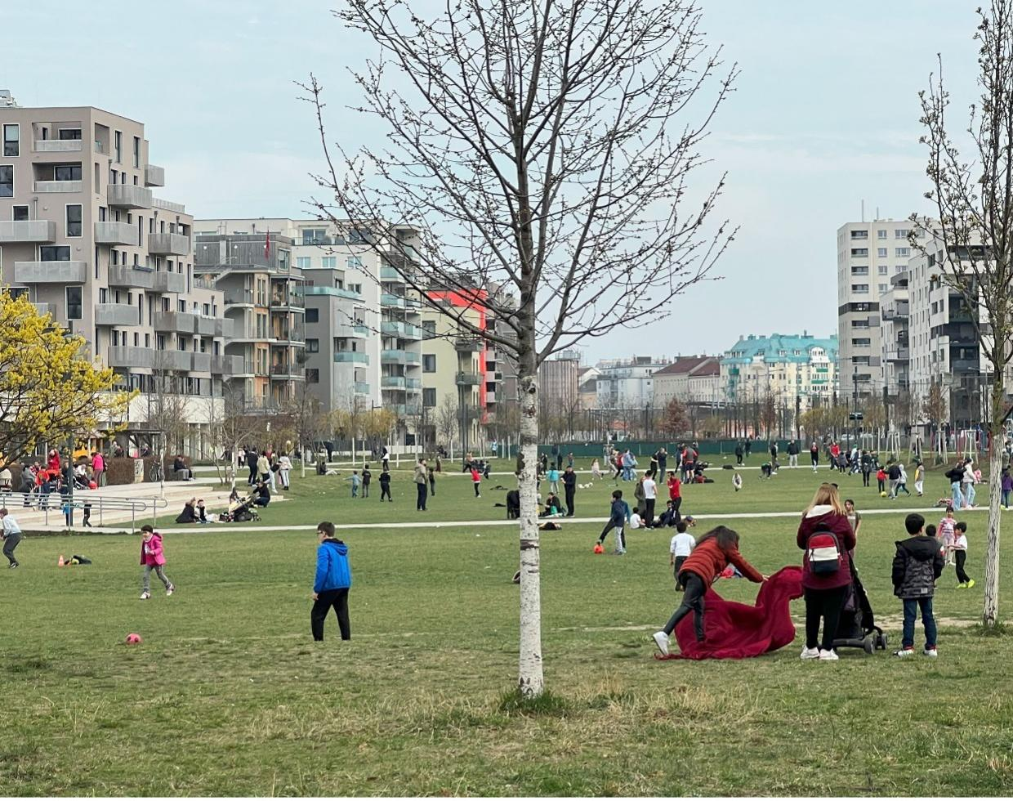

Innovating Mixed-Income Housing Concepts in the United States:
VIENNA, AUSTRIA’S APPROACH
VIRGINIA HOUSING COMMISSION
December 17, 2024

Slide 2





LESAR PORTFOLIO OF FIRMS
4 Synergistic Systems Change Firms
The LeSar firms work to advance our portfolio mission to forge solutions to intractable global challenges through
systems change.
Transformational learning and high-impact global leadership and workforce development
Management consulting
including transactional and planning work
Program design, implementation & on-going management and evaluation
Holding company with executive and operational functions
2

Slide 3
THE HOUSING CRISIS IN THE US AND VIRGINIA

Slide 4
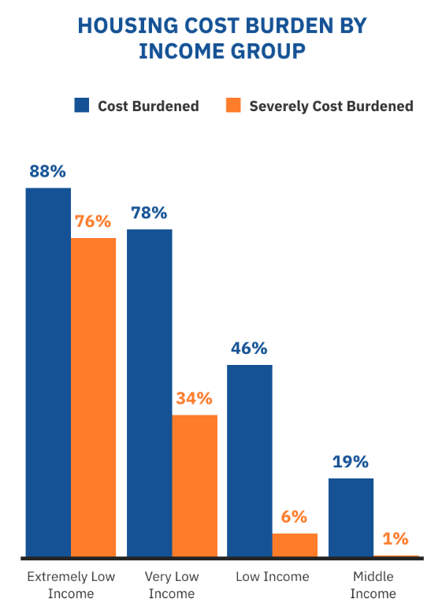
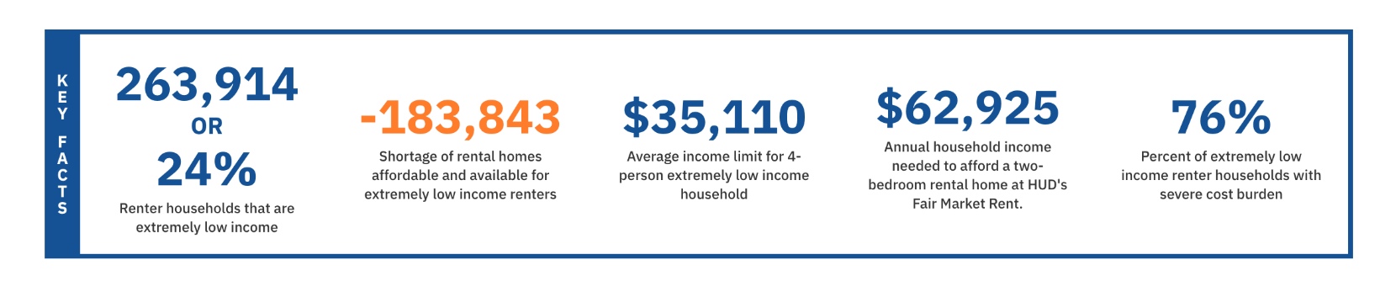

PERSISTENT UNDER-PRODUCTION
VIRGINIA AFFORDABLE HOUSING: KEY FACTS
Source

Slide 5
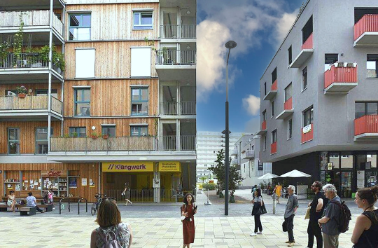

WHAT IS SOCIAL HOUSING?
  Intentionally planned and developed mixed income communities
  Government-owned or regulated permanently affordable housing
  Housing security through permanently rent-restricted homes tailored to local needs
  Prioritizes high-quality, affordable housing for the middle class
  Not influenced by market-driven price fluctuations

Slide 6
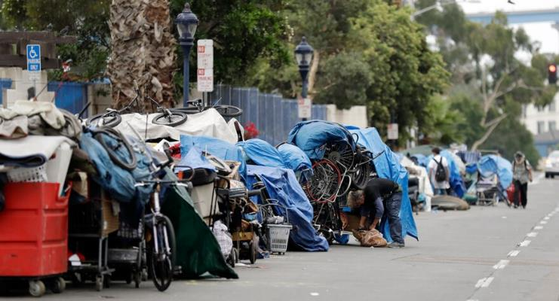
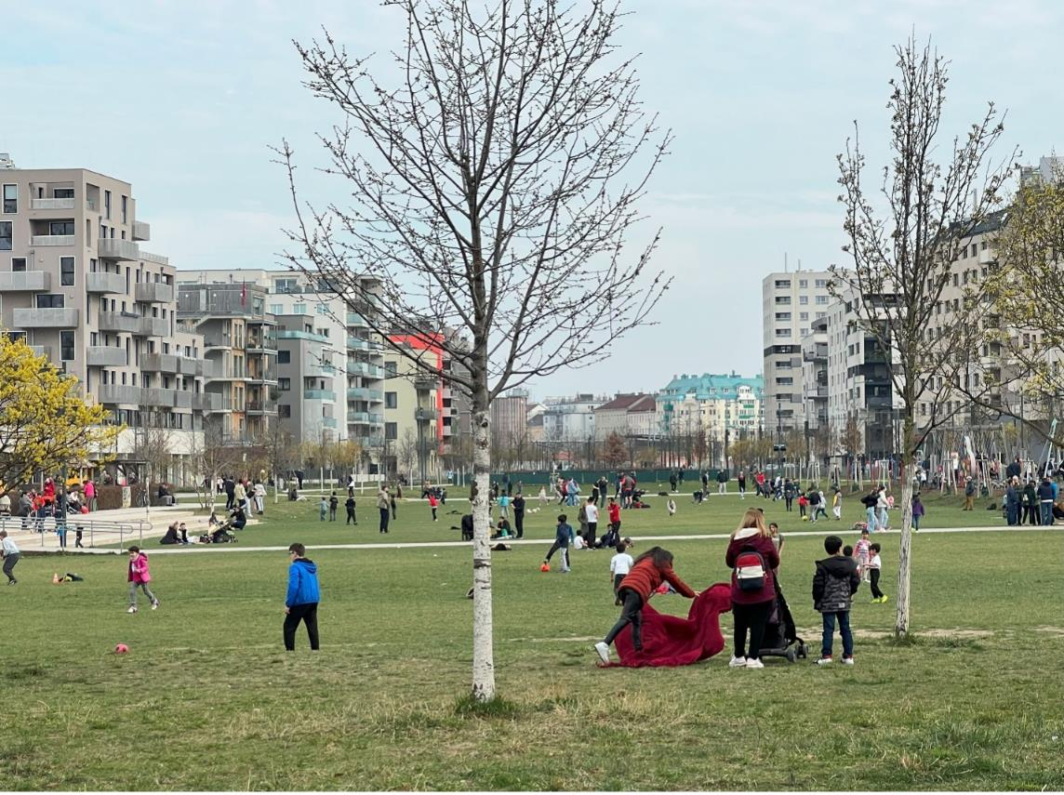

How will we live tomorrow?
Vienna today
U.S. CITIES today

Slide 7
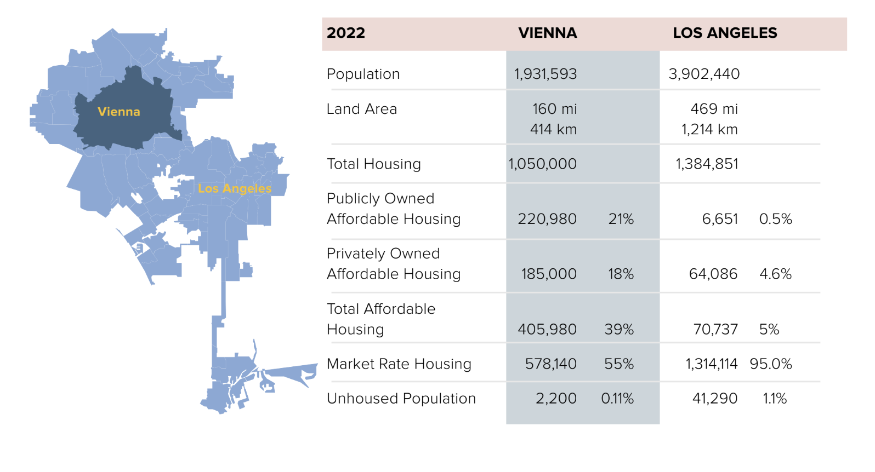
VIENNA STATISTICS

Slide 8
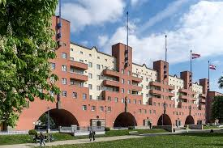
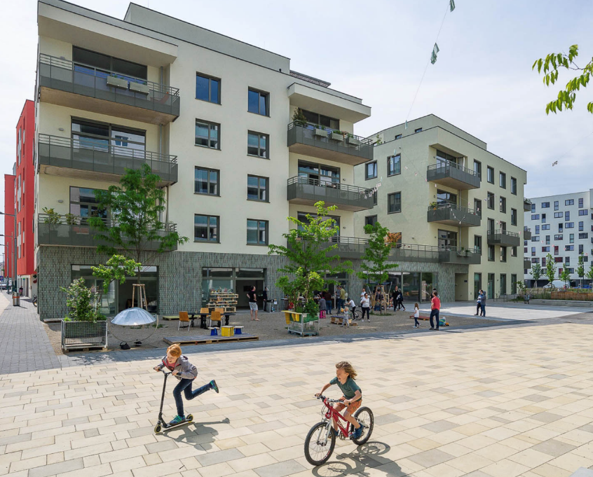
VIENNA’S HOUSING
Housing is a Human Right
People-centered planning for inclusive and sustainable communities
Prominent government role in providing housing options for all
Integrated housing system with a single point of entry
Prioritized infrastructure investment

Slide 9
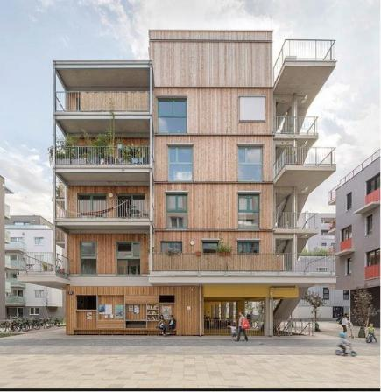
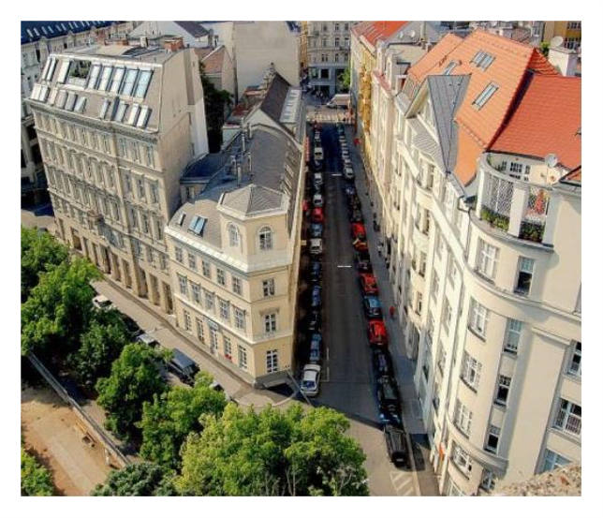
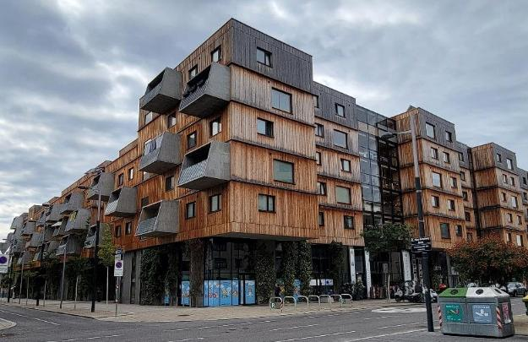
VIENNA HOUSING
60% of city residents (1.97 million) live in social housing​
​
Spend average of 27% of their household income on housing ​
​
​Effectively no homelessness, no housing insecurity​
New construction, in-fill and housing preservation elements
10-year path to homeownership​

Slide 10
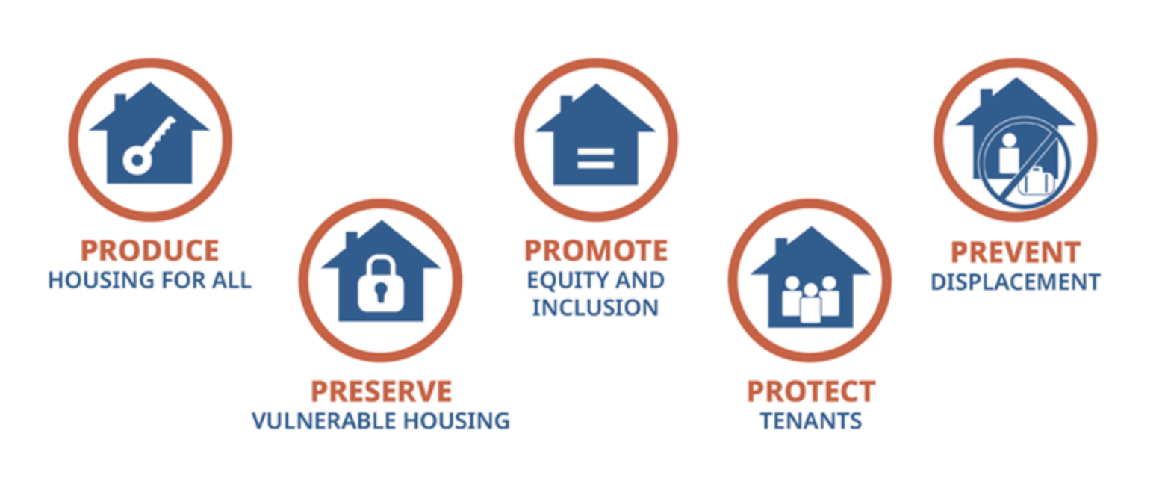

5P FRAMEWORK: PRODUCE
City takes an active role in acquiring, funding, regulating, managing, and incentivizing housing
Builds enough housing to meet local demand - 5,000 – 10,000 homes per year
Social housing includes Middle Class
€ 440 million generated annually for public sector use related to housing initiatives
Broad diversity in types of social housing

Slide 11
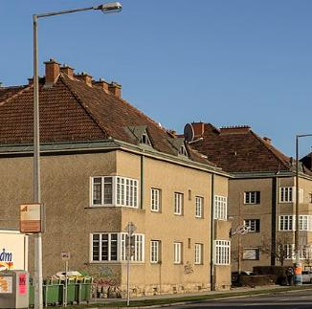
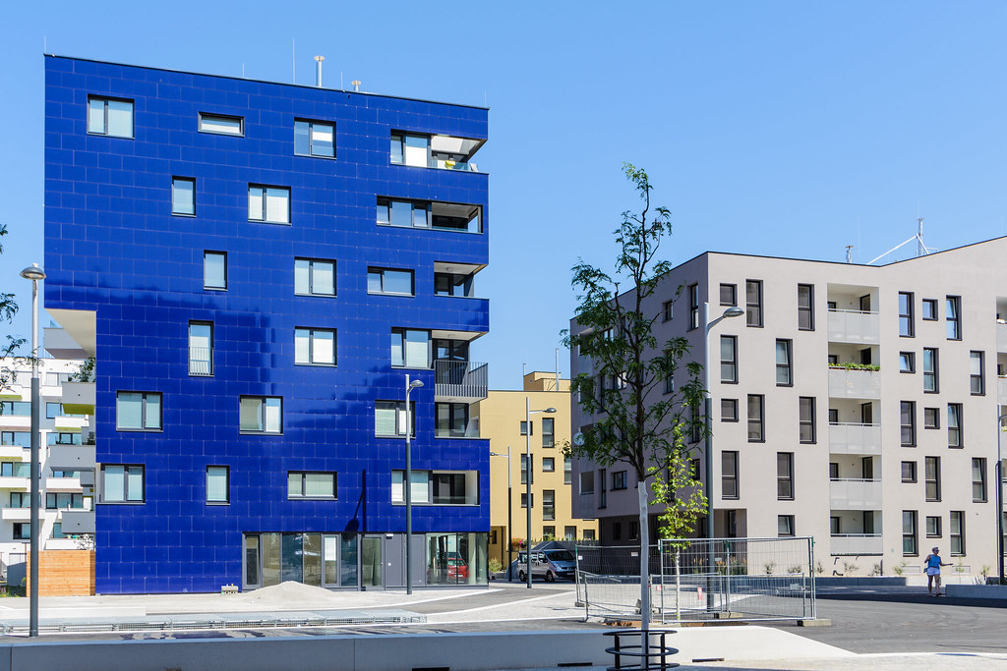

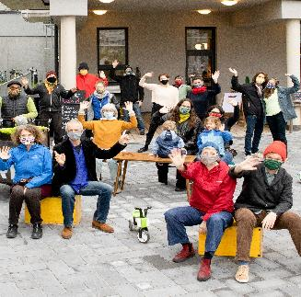
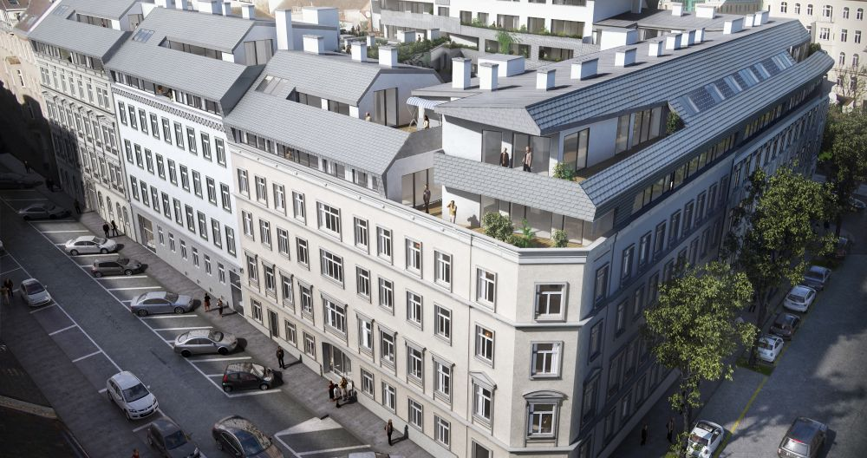
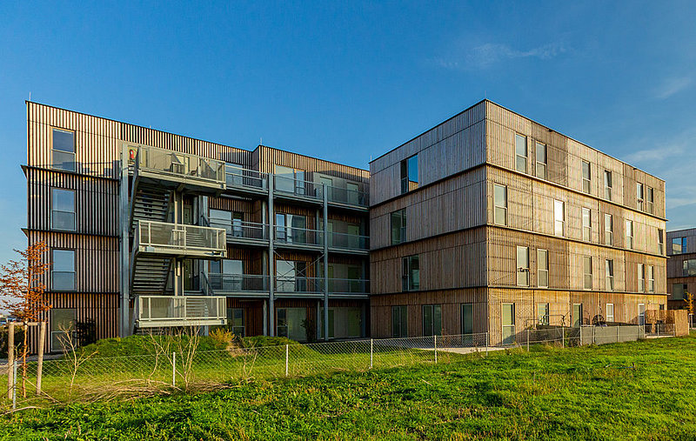
HOUSING TYPES IN VIENNA
Municipal Housing
Limited Profit Housing Association
SMART Apartments
Owner Cooperatives
Gentle Density
Temporary Emergency Housing

Slide 12
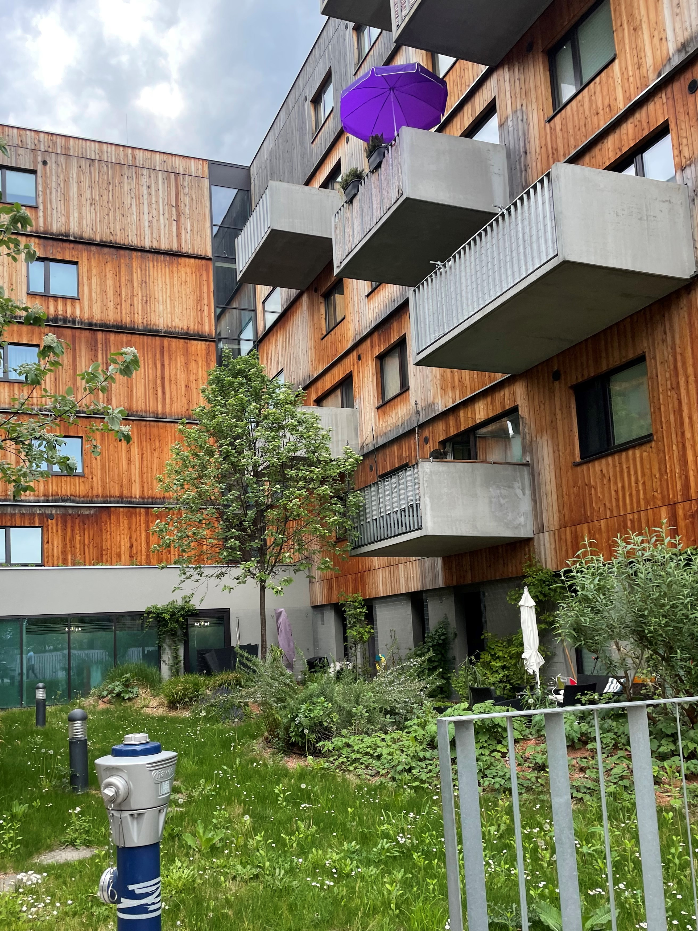
5P FRAMEWORK: PRESERVE
Most social housing designed to be permanently affordable
City takes measures to preserve housing that is at risk of being converted to market rate housing
City owns and manages 220,000 housing units (22% of city's housing stock)
Gentle Urban Renewal Project preserves the quality of Vienna's housing stock

Slide 13
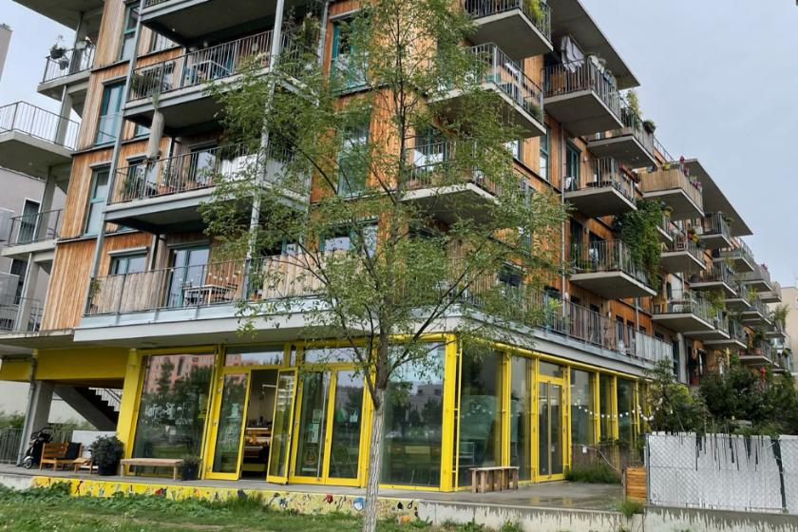
5P FRAMEWORK: PROMOTE
City has a "social mixing" policy that integrates households from different professions and backgrounds
Social Housing Zoning requires certain developers to designate 2/3 of new housing units as permanent affordable housing
Intersectional and integrated planning to promote livability, mobility and sustainability
Pathway to homeownership after 5-10 years of occupancy

Slide 14
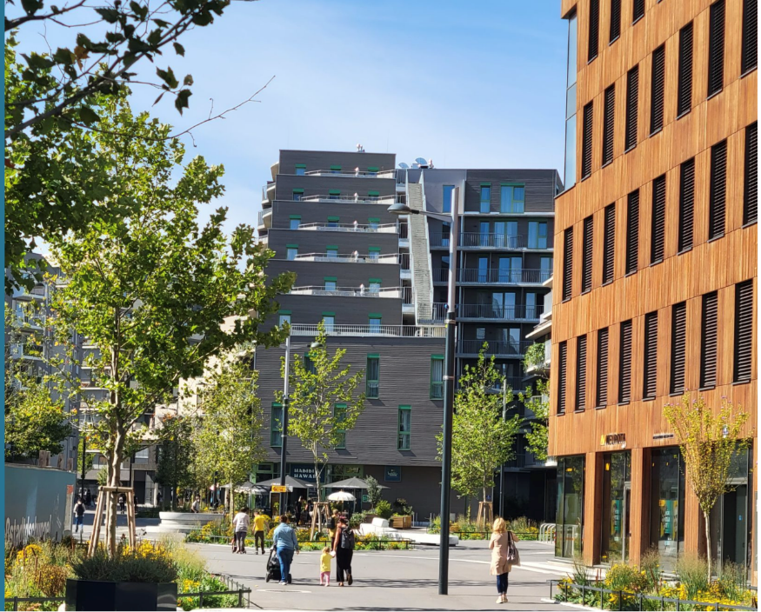
5P FRAMEWORK: PROTECT
Policies and programs to reduce evictions, eliminate illegal rent gouging
Rent Control
  Open-Ended Leases
  Just Cause Eviction Protections
  Right of Inheritance/Transfer
City supports tenants through programs which provide leasing assistance, and legal support
Needs based system of allocation for lower-income units

Slide 15
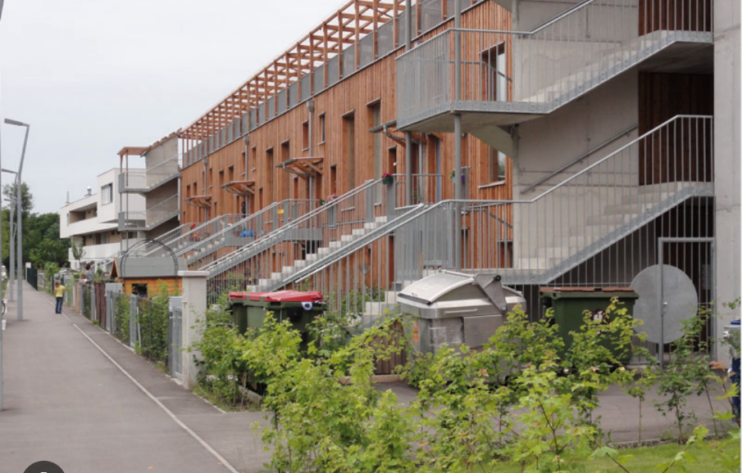
5P FRAMEWORK: PREVENT
Policies that prevents households from being displaced due to market pressures
City provides those with eviction notices immediate rental assistance and tenant rights support
Families never required to move out even if income increases – income verification done once
Rehabilitation of apartments done in a way that minimizes displacement

Slide 16
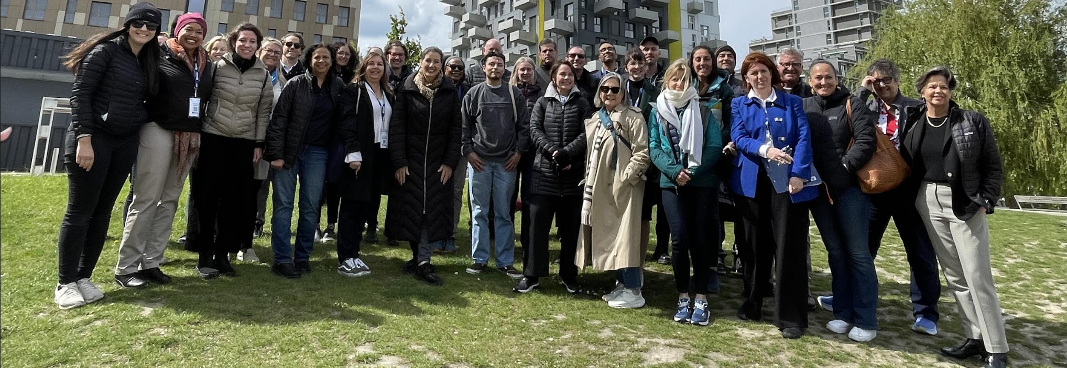
GPLA VIENNA FIELD STUDY
Elected officials
Developers
Philanthropy
Trade Associations
Advocacy
Government
Education
Healthcare
Social Services Partners
Los Angeles, CA
San Diego, CA
Bay Area, CA
Inland Empire, CA
Portland, OR
New York, NY
Hawaii
2022-2024
5
197
COHORTS
DELEGATES

Slide 17
LESSONS LEARNED
Plan and build at scale on public lands
Restore government role in infrastructure development
Ensure permanent funding and a simpler capital stack
Use the new regional housing finance agencies for innovative models
Plan and build for the middle class in mixed-income communities
Promote alternative housing models
Create a new housing narrative

Slide 18
Social Housing In THE U.S.
MONTGOMERY COUNTY, MARYLAND
AFFORDABLE HOUSING OPPORTUNITY FUND - $20M REVOLVING FUND TO ENABLE PRODUCTION OF 9K MIXED-INCOME HOUSING UNITS
LAUNCHED THE ATLANTA URBAN DEVELOPMENT CORPORATION TO BUILD NIXED-INCOME HOUSING ON PUBLICLY-OWNED LAND
ATLANTA, GEORGIA
SEATTLE, WASHINGTON
ESTABLISHED THE SEATTLE SOCIAL HOUSING DEVELOPER – A PUBLIC DEVELOPMENT AUTHORITY IN 2023
CALIFORNIA
CA SENATE BILL 555 REQUIRES HCD TO COMPLETE A SOCIAL HOUSING STUDY BY 2026
LOS ANGELES APPROVED A 4% TRANSFER TAX THROUGH MEASURE ULA (United to House LA) TO UNLOCK MONEY FOR PRODUCTION OF SOCIAL HOUSING

Slide 19

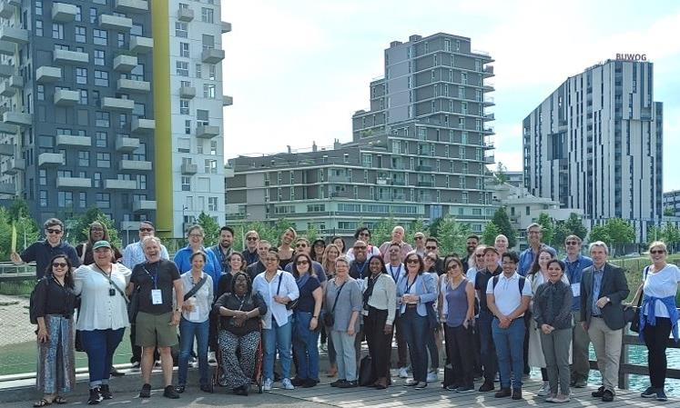
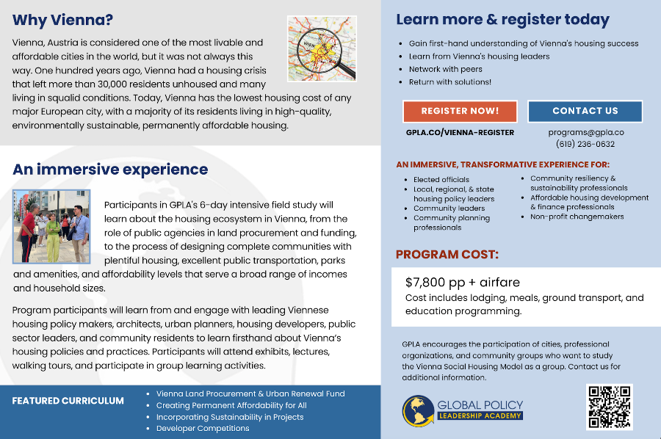

VIENNA FIELD STUDY 2025
GPLA.CO
PROGRAMS@GPLA.CO

Slide 20
CONTACT:
Pamela Kestner
Chief of Staff
540.353.4264
pamela@gpla.co
GPLA.CO
PROGRAMS@GPLA.CO
THANK YOU!

